Slide 1
Analyzing spatial models, continued
AIMS Day 4

Slide 2
Assessment
30% quiz tomorrow (30 minutes, 10 multiple choice/fill in the blank questions)
Open material quiz
When would we choose between Lagrangian and Eulerian models?
What are the pros and cons of various data types?
Gravity, radiation models of mobility
Calculating centrality from a graph
30% worksheet 4
40% completed worksheets 1-3 (effort grade)
Email worksheets to nrukt00@gmail.com by 4PM Friday

Slide 3
Learning objectives
Understand what is often observed in spatial models
Stochastic extinction: Why does this happen? What is the role of “synchrony”?
Identifying transmission sources and sinks
Wave dynamics: What is a “wave”? What dictates how fast the wave moves?

Slide 4
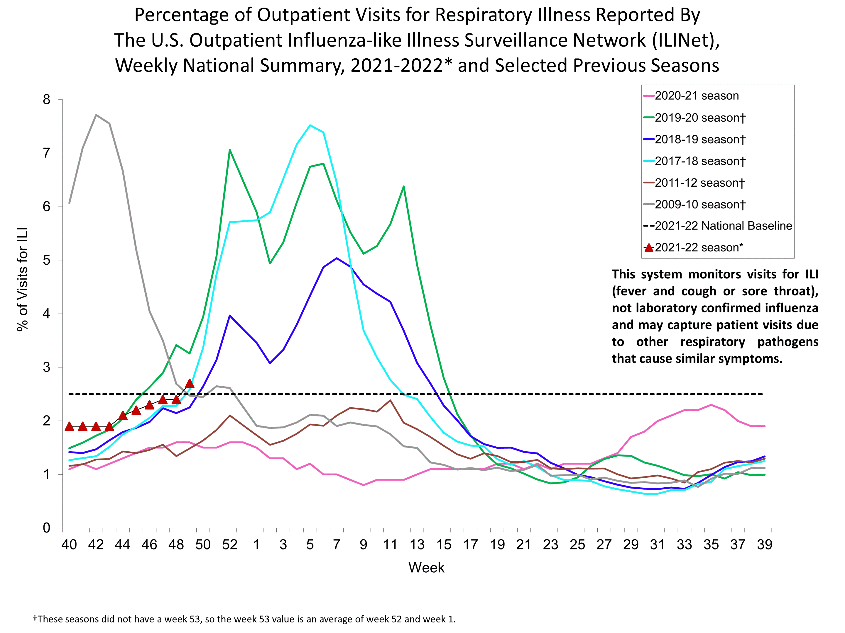
Lagrangian movement: Local scale
Spread of influenza-like illness in London, through Underground
Islington: Less connected, longer trips
Kensington/Chelsea: More connected
Do longer trips correlate with more ILI?
https://ehjournal.biomedcentral.com/articles/10.1186/s12940-018-0427-5

Slide 5
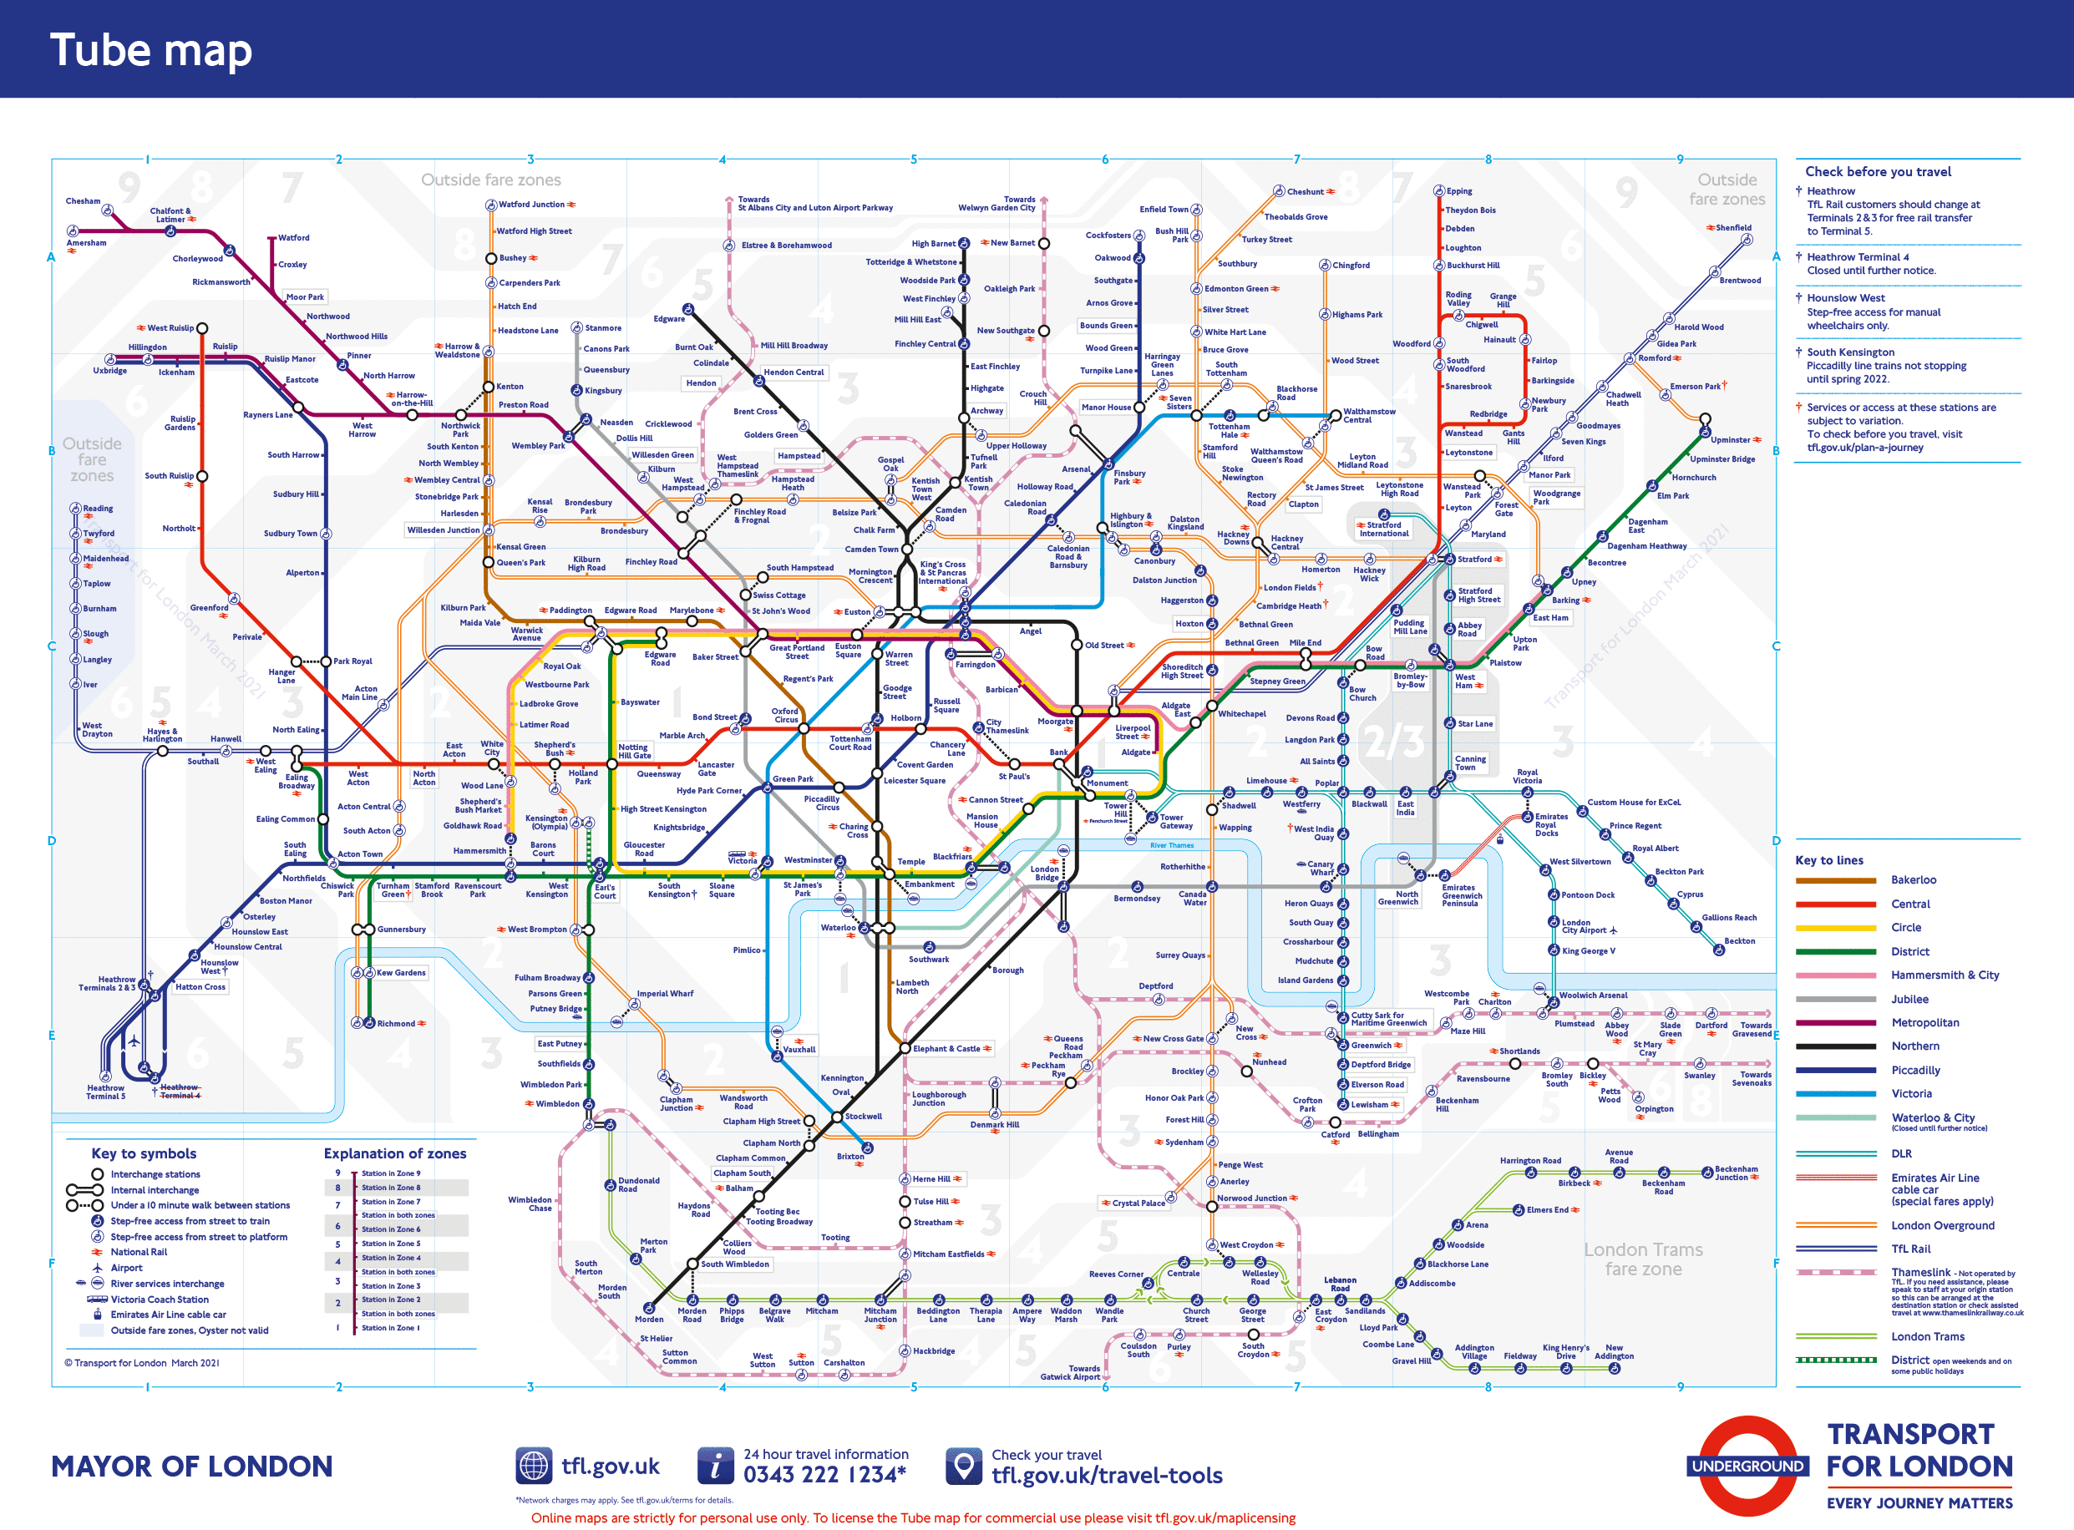

Slide 6
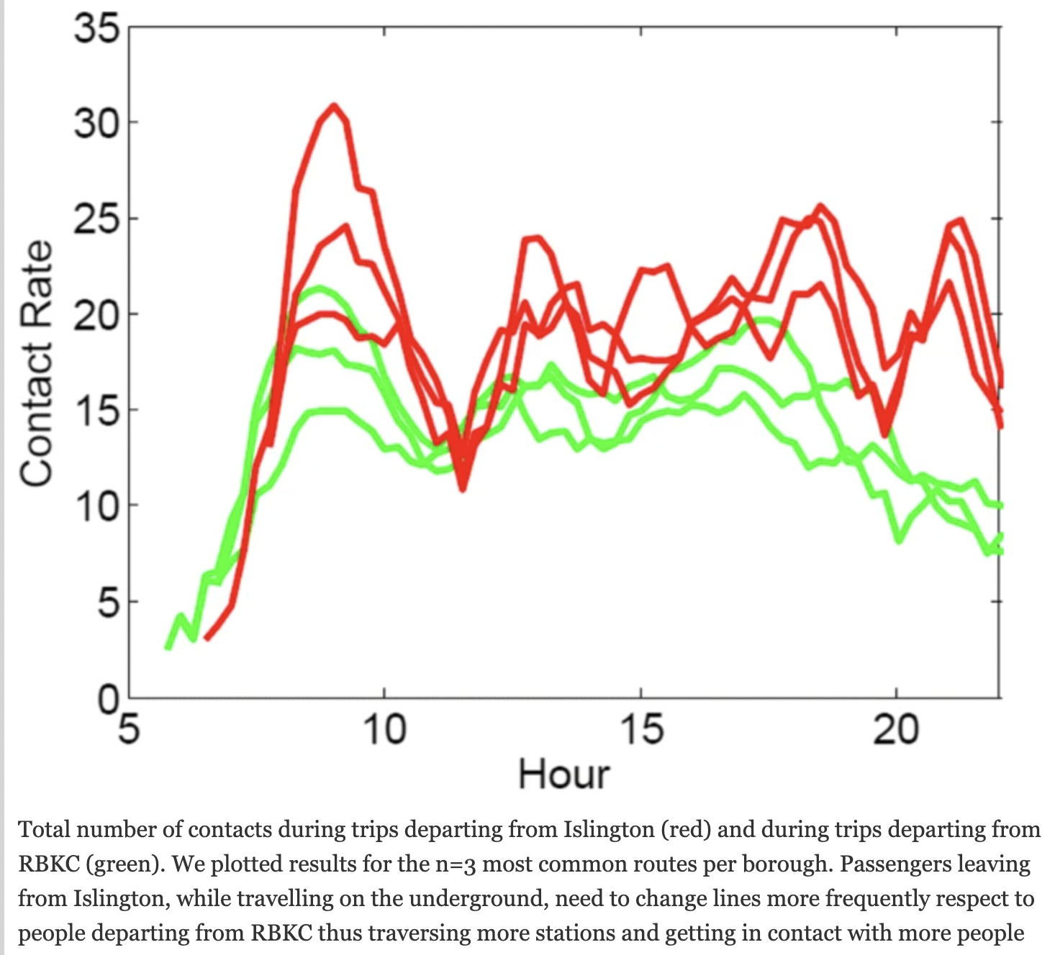
Lagrangian movement
Compared transmission predictions based on differences in contacts
Found positive correlation between underground contacts and ILI (correlation = .44, p=.0293)
People traveling from Islington had more contacts

Slide 7
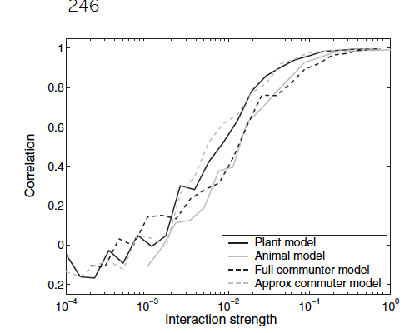
What do we observe in spatial models?
More strongly connected, the more synchronized their epidemics
Disease becomes more likely to die out: “Stochastic extinction”
Network/wave dynamics: Key nodes

Slide 8
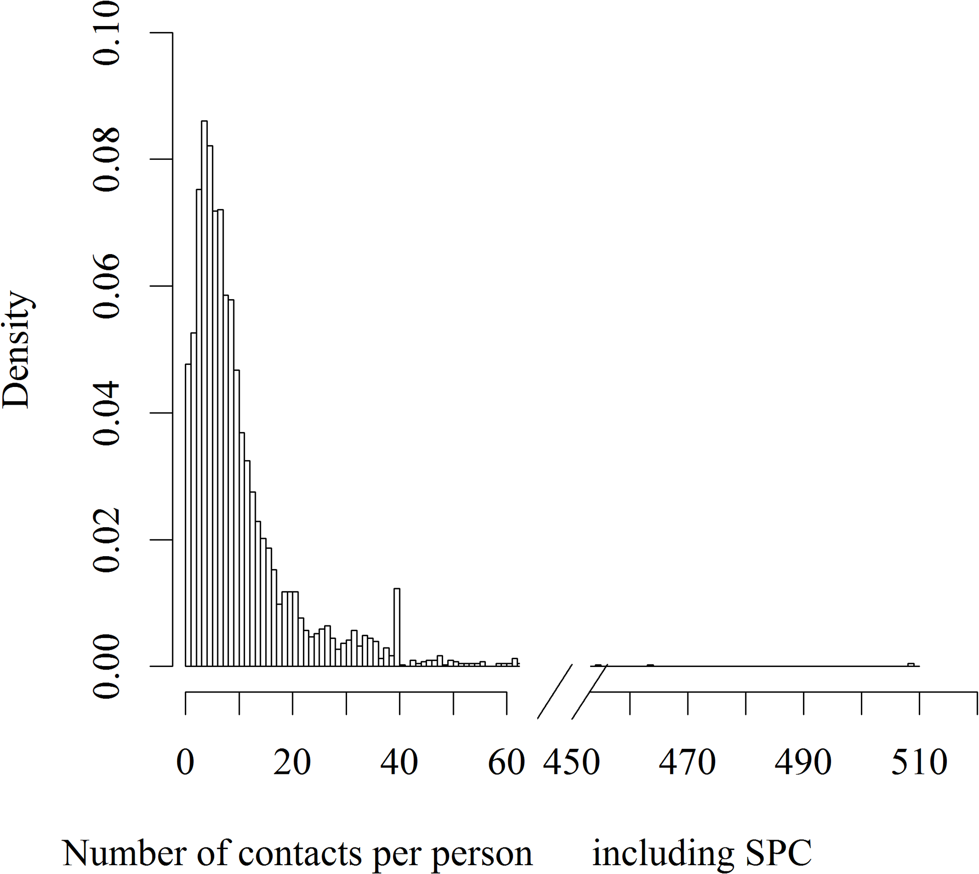
Stochastic extinction
Randomness is a huge driving factor in epidemic spread
Especially in small populations
Small numbers infected = more likely to infect all people with few contacts/people who recover quickly
Can cause localized extinction even when R0 > 1

Slide 9
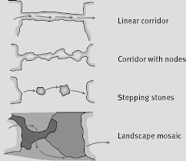
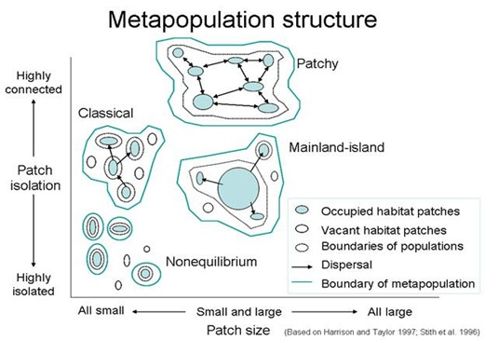
”Metapopulation” dynamics
Common issue in ecology—fragmented landscapes mean species more likely to die out
Opposite concern in disease
Can we take advantage of increased extinction likelihood?

Slide 10
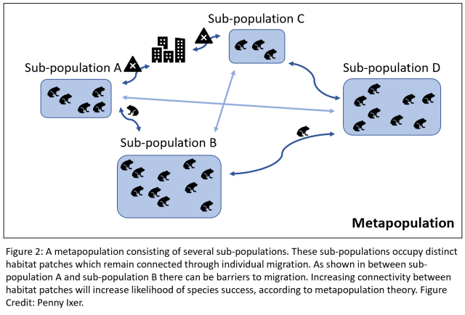

Slide 11
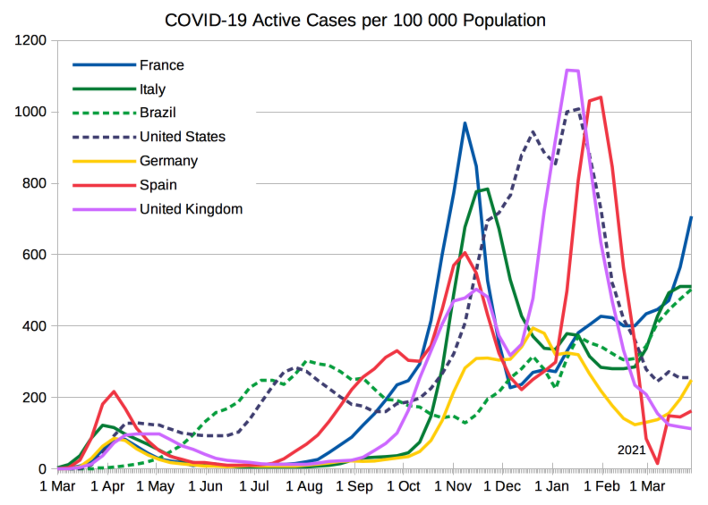

Slide 12
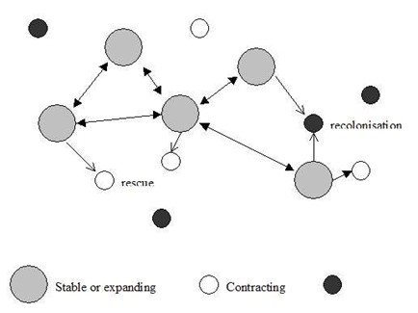
Source/sink dynamics
Commonly, some areas are higher transmission than others; net exporters of cases
Some are sustained only by importation; net importers

Slide 13
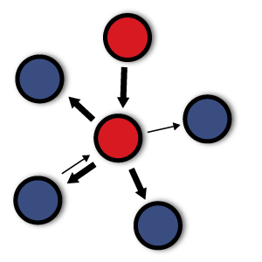
Source-sink dynamics
Sources: Areas that export cases, and lead to an outsized effect on transmission
Very effective intervention targets
Sinks: Import cases, would not have cases if not for importation
Surveillance targets

Slide 14
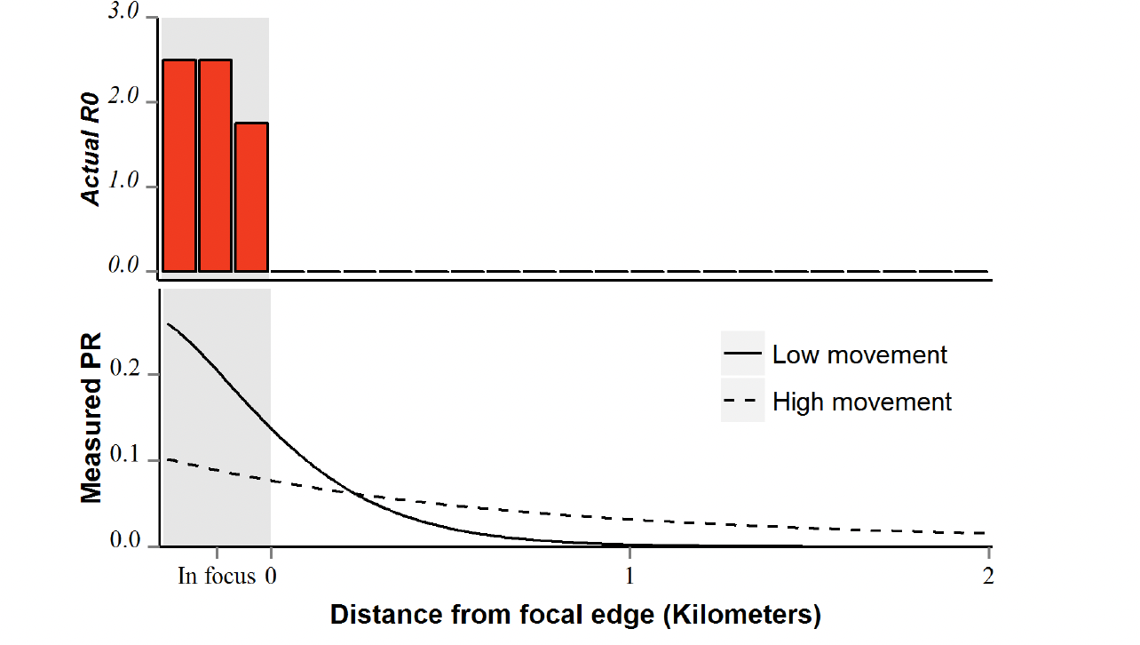
“Focal” transmission

Slide 15
Simple SIR model example

Slide 16
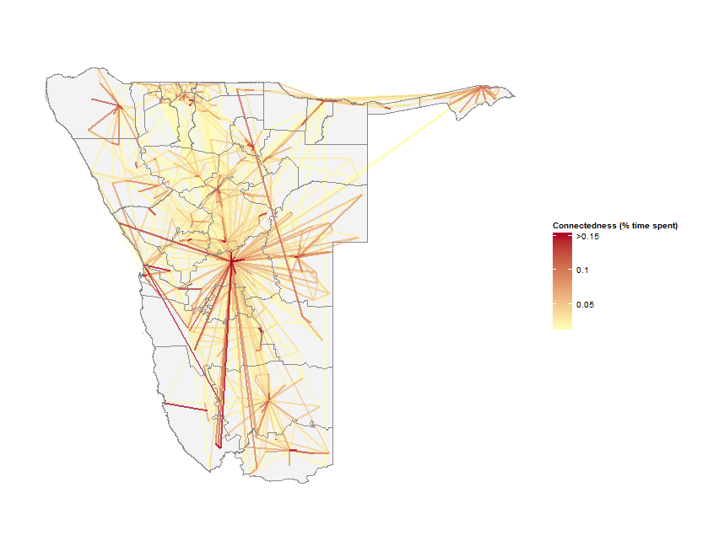
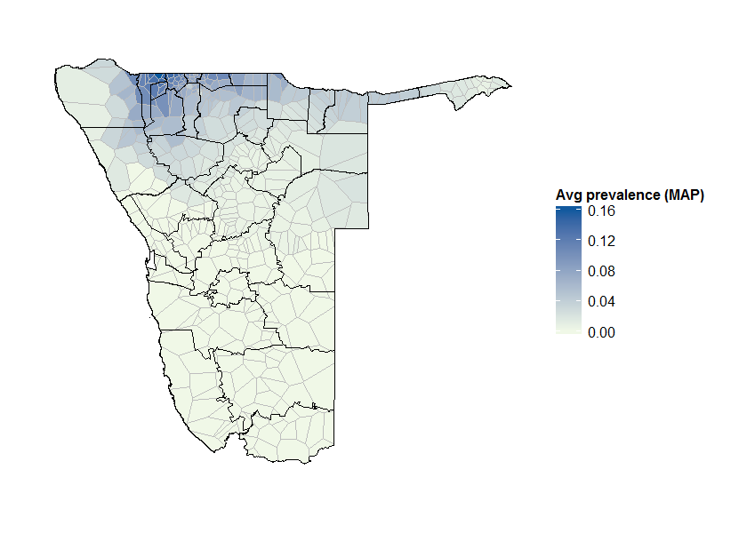
Assessing risk: Mapping sources and sinks
?
+
=
Local transmission
Mobility
Observed burden
What level of transmission yields observed prevalence?

Slide 17
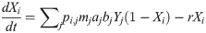
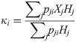
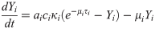
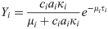
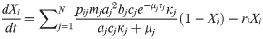
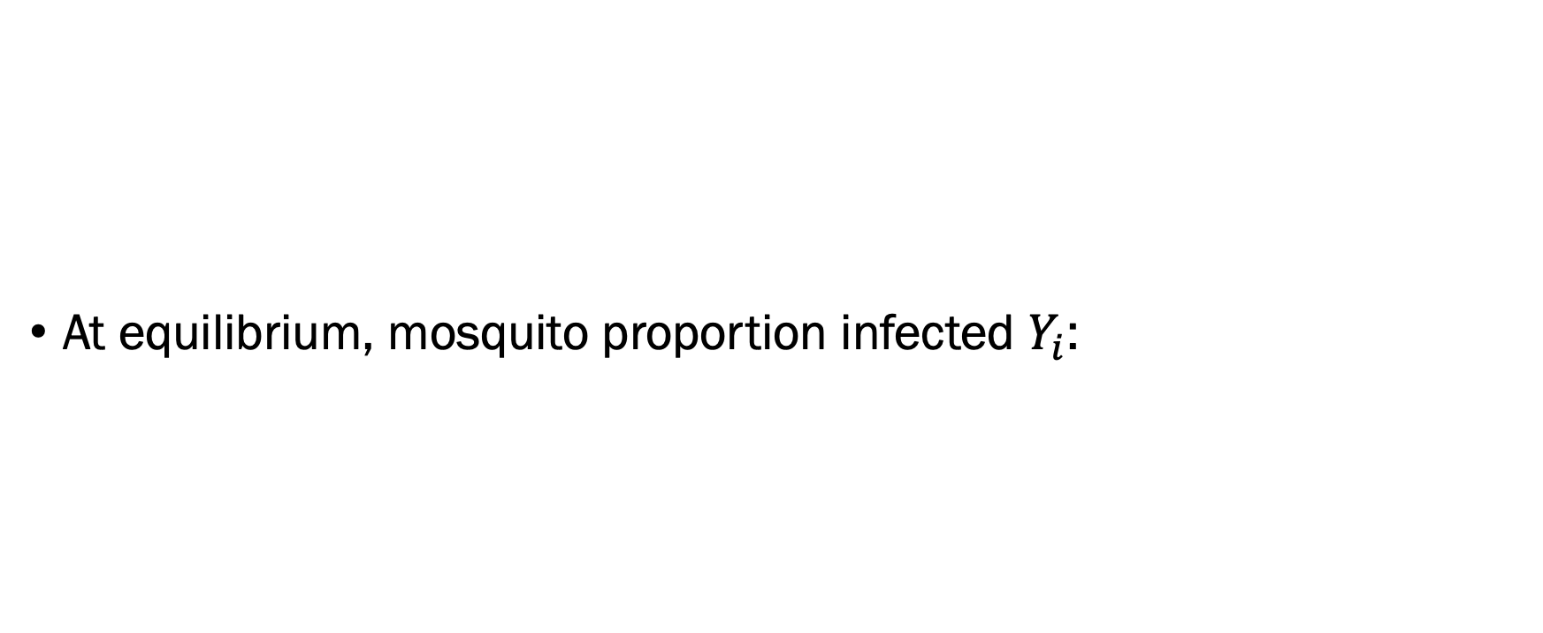
At equilibrium, mosquito proportion infected $Y_{i}$:

Slide 18
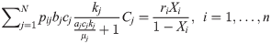
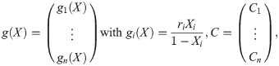
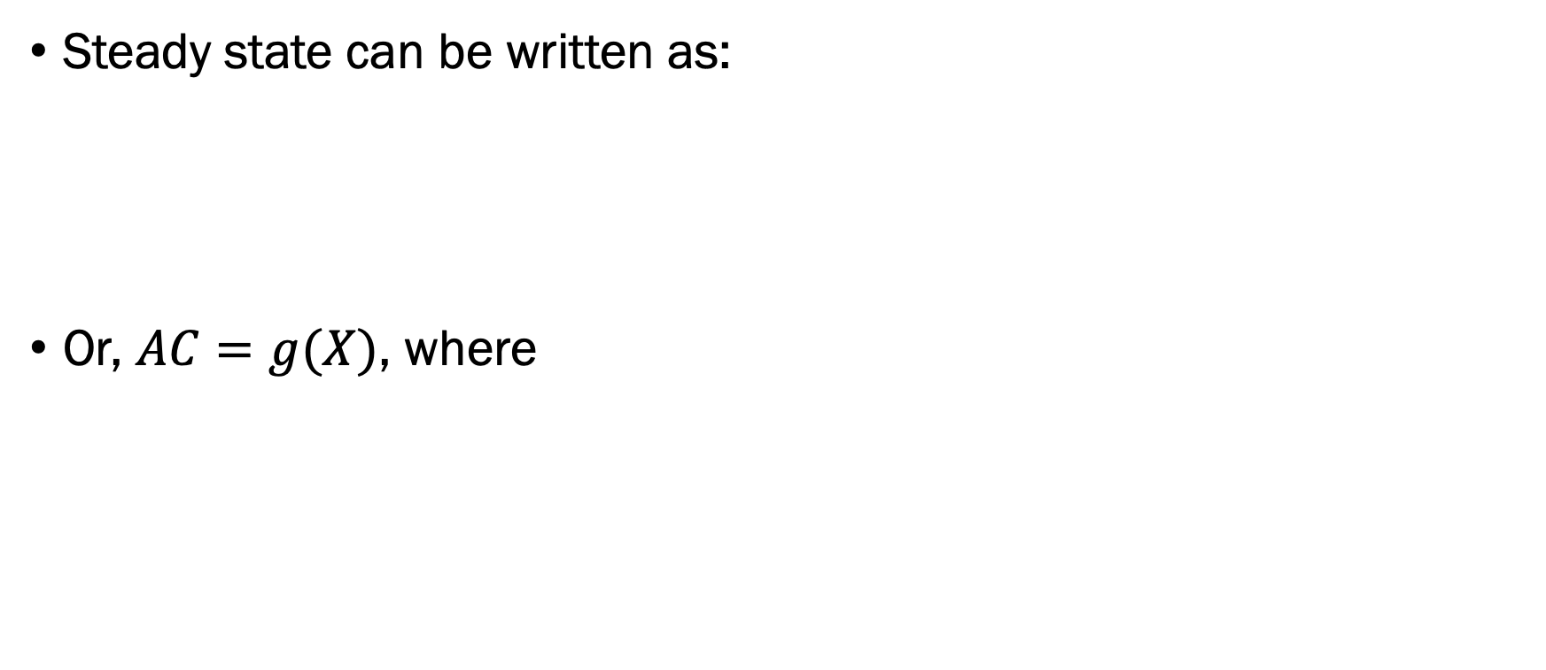
Steady state can be written as:
Or, $AC=g(X)$, where

Slide 19
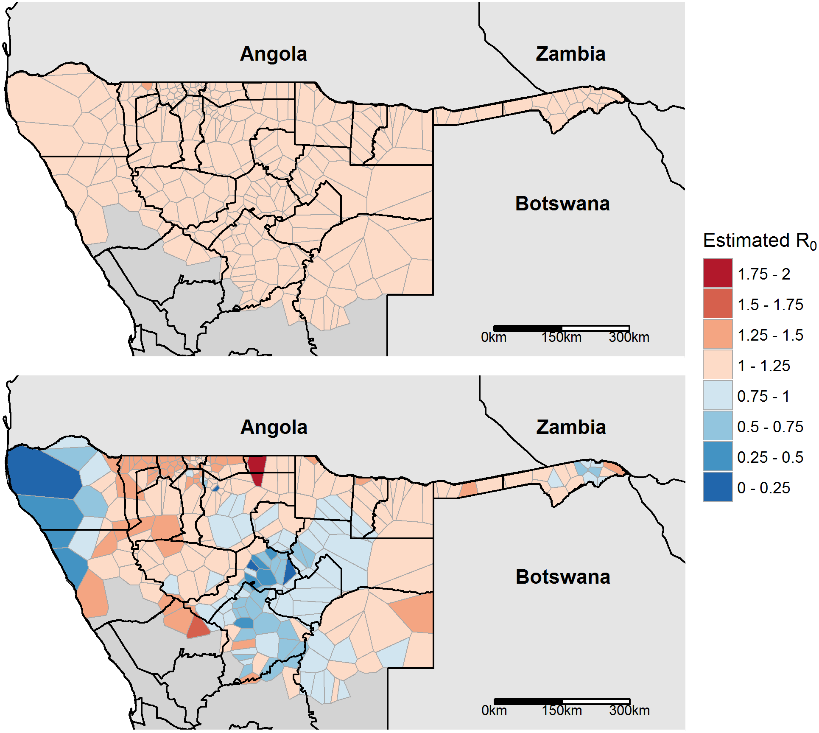
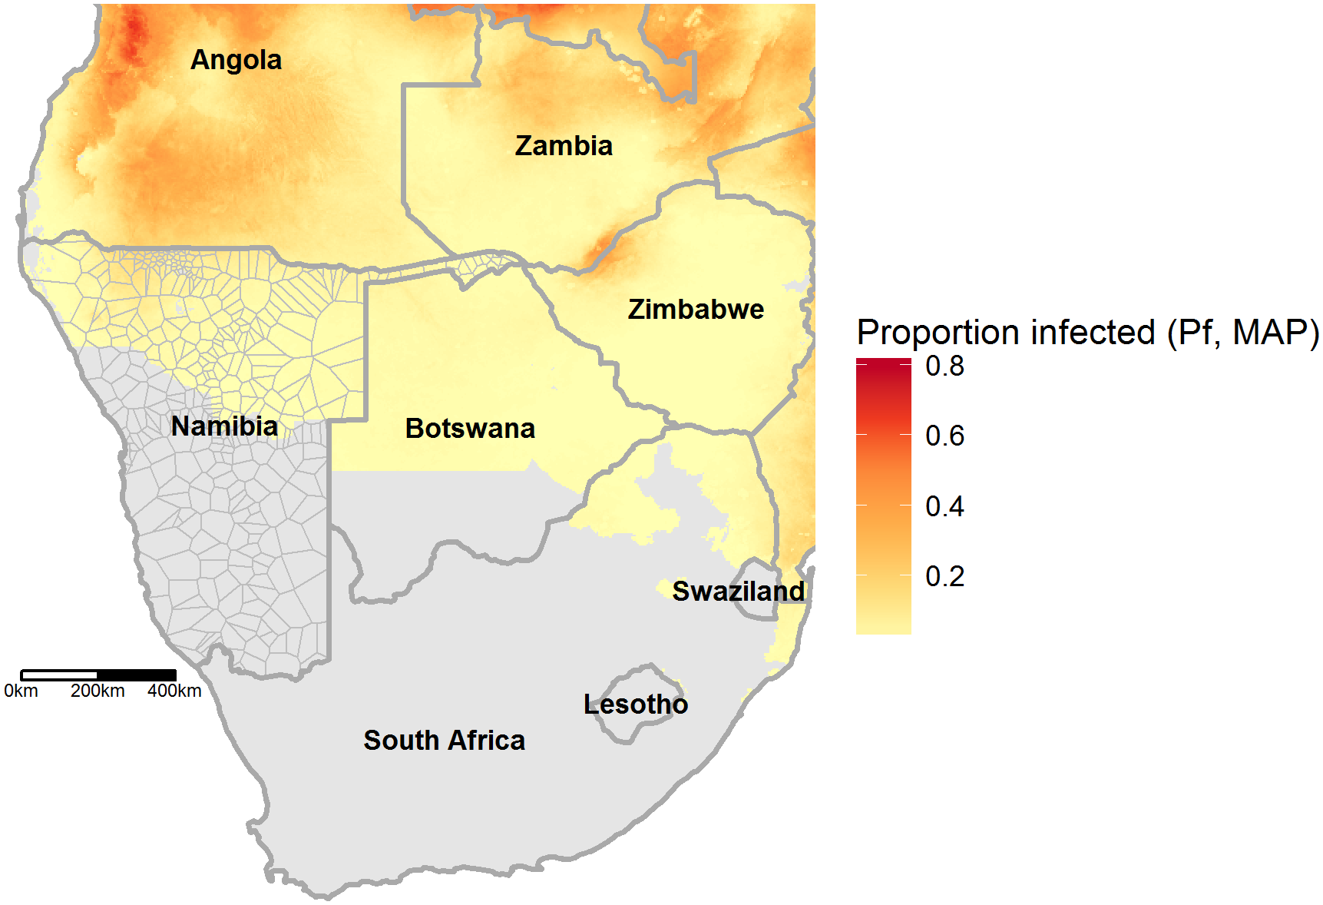
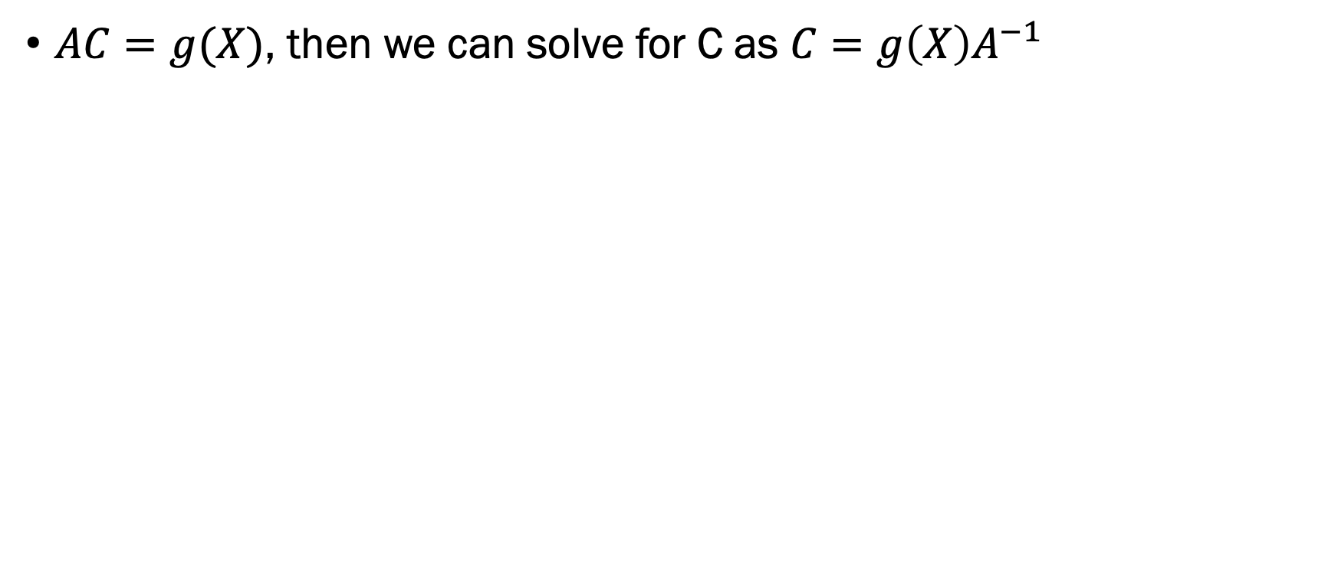
$AC=g(X)$, then we can solve for C as $C=g\left(X\right)A^{−1}$

Slide 20
Metapopulation dynamics
Sources and sinks are not always static
Some areas will be “expanding” or ”stable”, others contracting
When might we expect a shift between source/sink?
For respiratory disease?
For malaria?

Slide 21
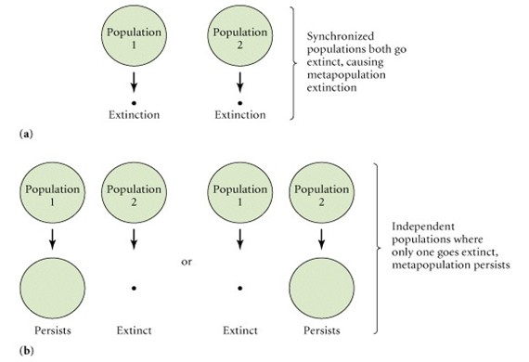
Synchrony/asynchrony
If populations are synchronized, more likely that extinctions will happen at the same time
High synchrony: global extinction possible
Low synchrony: Regional persistence

Slide 22
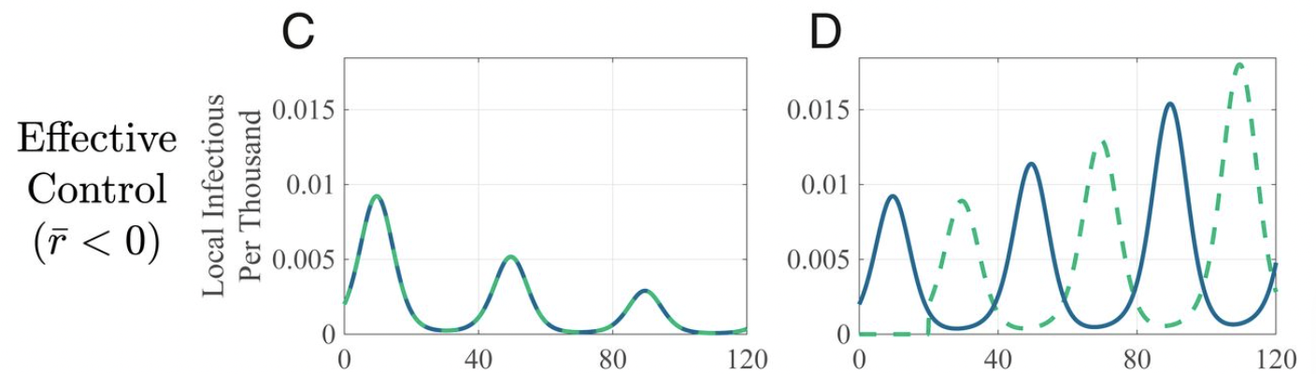
Timing control makes a big difference
Different interventions can induce “synchrony”/”asynchrony”
Everybody under self-isolation at the same time
Seasonality in behavior can, too
https://www.pnas.org/content/117/48/30104

Slide 23
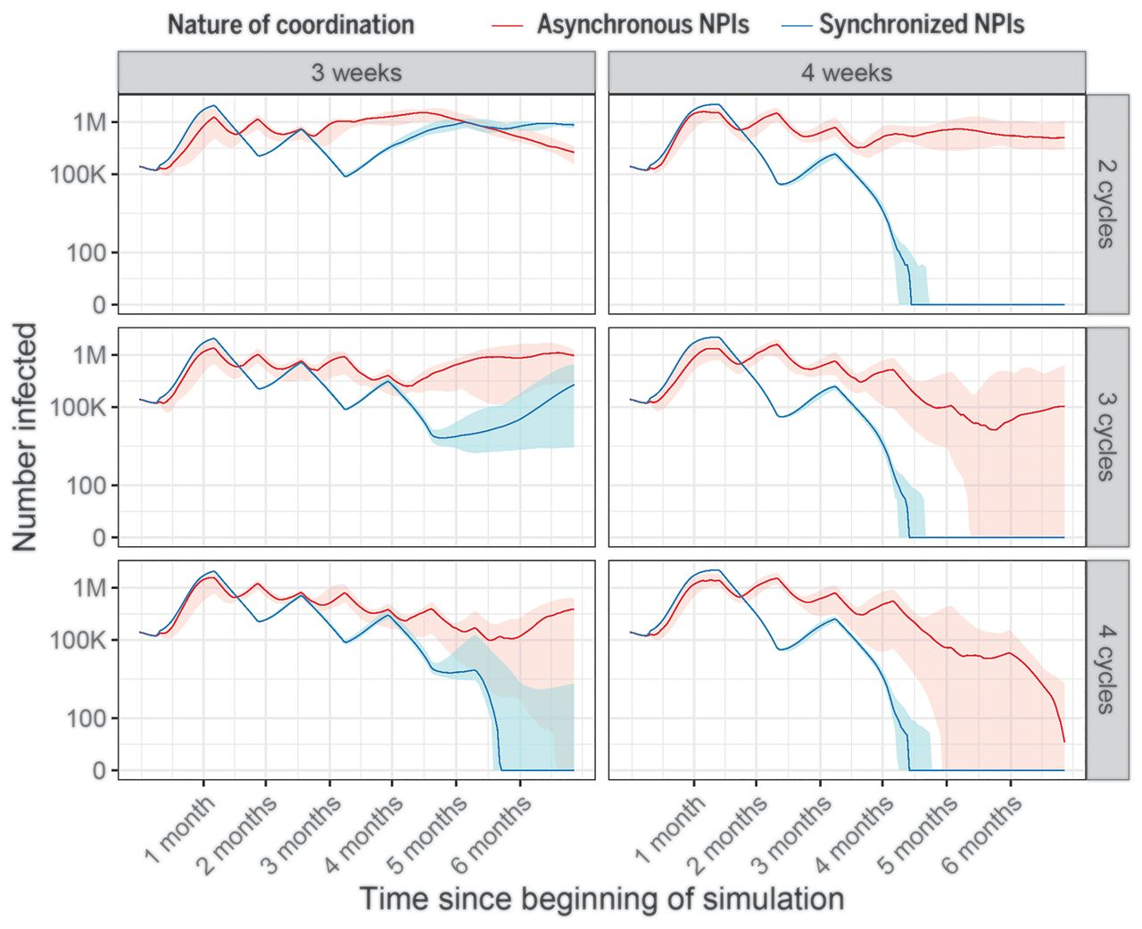

Slide 24
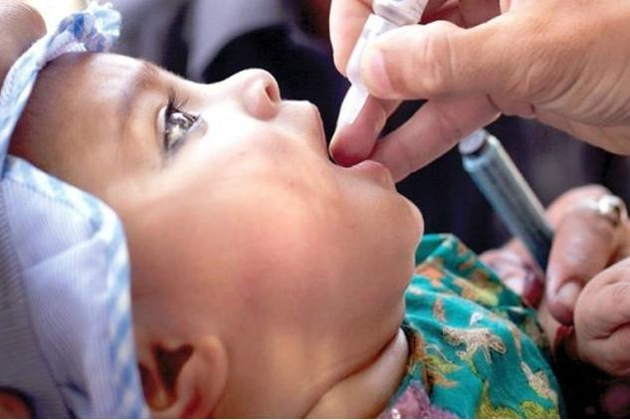

Pulsed vaccination
Attempt to synchronize effect of vaccination across subpopulations
Strong synchronized reductions hopefully drop things to zero
Common for polio

Slide 25
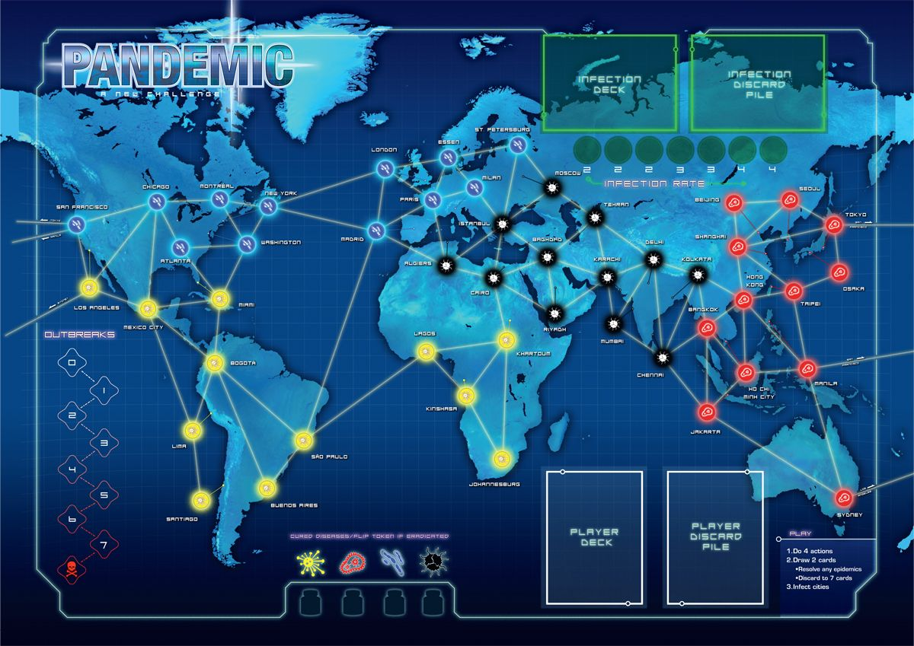
Connectivity between places: Usually more than just a few patches

Slide 26
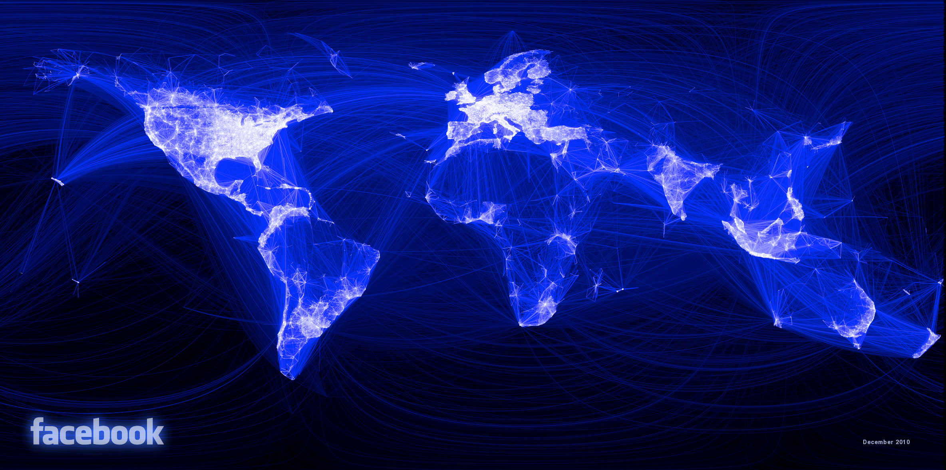

Slide 27
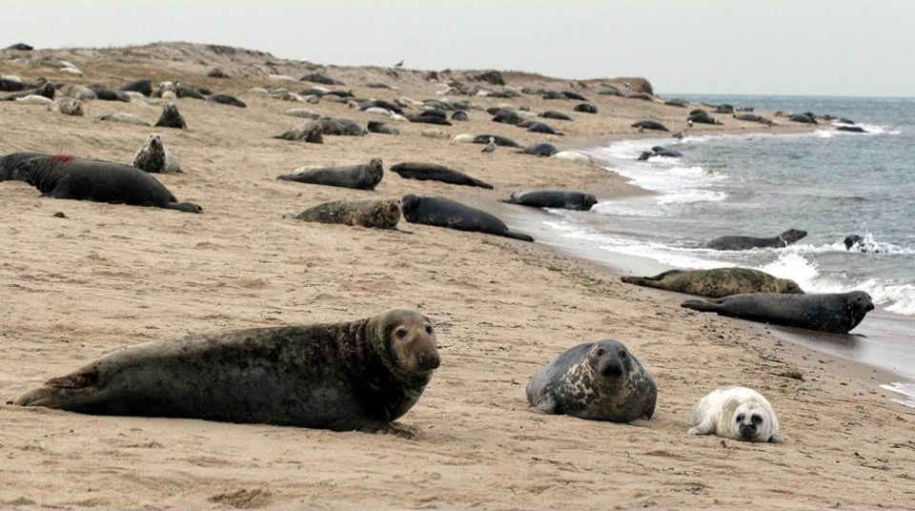
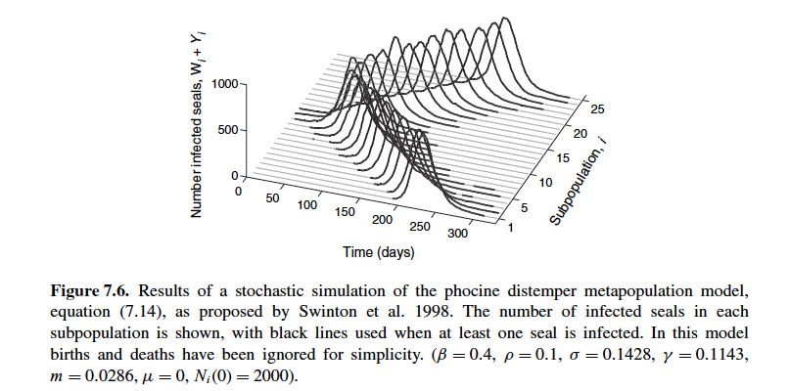
Wave dynamics: Phocine distemper virus
Virus that created an outbreak in seals in 1988—decimated seal populations
Social groups within very large colonies—limited mixing
Initial spread occurred over a year, and spread out of subpopulations over time

Slide 28
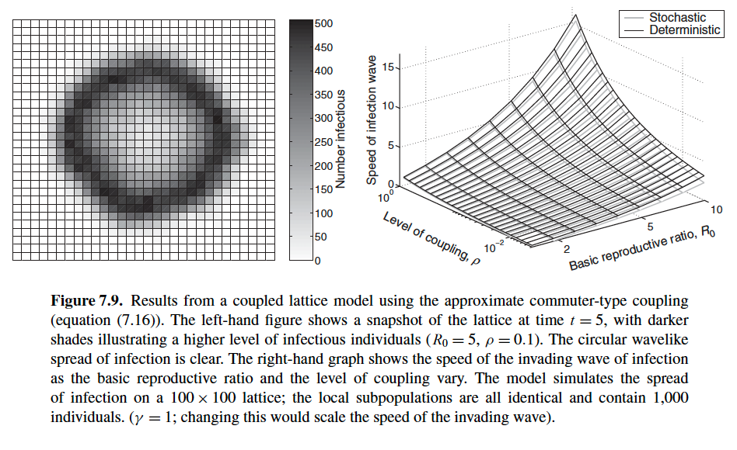
Wave speed
In general, spread depends on two factors:
Interconnectedness and reproductive number

Slide 29
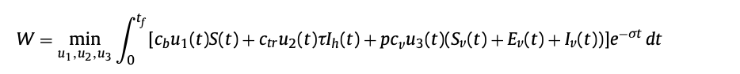
Optimal control
Often, there are public health and economic considerations
If we can only purchase so many bednets or treatments, how should we allocate them?
Can these considerations be quantified as a function that we would like to minimize?
Objective function: Summarizes the overall “cost” of cases + implementing new interventions

Slide 30
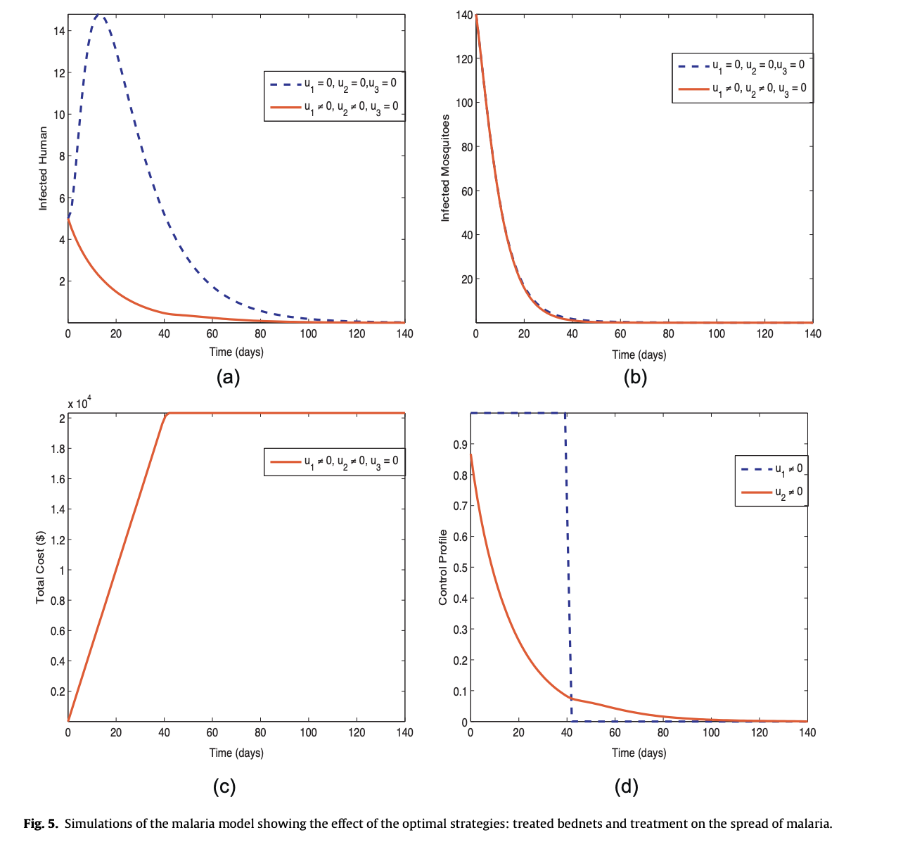
Optimal control theory
Determine ways to minimize the objective function over space and time
Commonly used to optimize placement of interventions across space

Slide 31
Spatial models
Lots of ways to incorporate space into a model: Has often key implications
Synchronized or strong connections means more likely to get synchronized epidemics, but also synchronized extinction
Affects control strategies like pulsed vaccination
Connectivity also often goes across longer distances/many patches
Reproductive number and connectivity influences wave speed, or the potential spread of an epidemic
Network and source sink dynamics… to be continued

